Slide 1




















01
ML Engineer
Data Analyst
05
Builds and implements machine learning models into production systems.
Interprets data to extract insights and support decision making.
02
AI Engineer
Data Scientist
06
Job Titles For AI and Data Scientist
Develops comprehensive AI solutions and smart applications.
Analyzes data and creates models to predict and extract insights.
03
ML Scientist
Data Engineer
07
Develops and improves advanced machine learning algorithms and models.
Builds and maintains data pipelines and data storage structures.
04
ML Researcher
AI Product Manager
08
Focuses on academic and experimental research in machine learning.
Connects business goals and AI teams to build a successful product.
Created by: Omar Mohsen

Slide 2












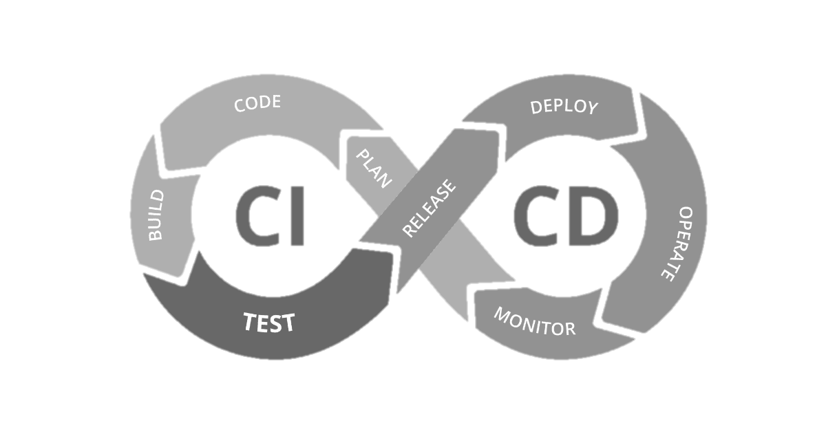





ML Engineer
Skills
Tasks
Python Data
preprocessing
Designing and packaging machine learning models
Tasks
Skills
TensorFlow /
PyTorch
Optimizing performance and reducing latency
Tasks
Skills
MLOps
(Docker, CI/CD)
Integrating models into production systems

Slide 3









AI Engineer
Skills
Tasks
Python
Building AI services
and APIs
Skills
Tasks
Designing inference systems
Computer Vision
NLP
Skills
Tasks
Handling production constraints
like scalability and security
Cloud (AWS/GCP/Azure)
APIs

Slide 4











ML Scientist
Skills
Skills
Skills
Research methods
Deep Learning theory
PyTorch/TensorFlow
Math & statistics
Tasks
Tasks
Tasks
Designing new
research experiments
Writing academic papers
and reports
Testing and
validating theoretical models

Slide 5















ML Researcher
Skills
Tasks
Scientific research
Innovating new methods and algorithms
Skills
Tasks
Advanced ML algorithms
Running detailed experiments and comparisons
Skills
Tasks
paper writing & experiment design
Publishing results in conferences or journals

Slide 6











Data Analyst
Skills
Skills
Skills
SQL & Basic statistics
Excel
Power BI / Tableau
Tasks
Tasks
Tasks
Creating reports and dashboards
Analyzing trends and patterns
Providing clear and actionable recommendations

Slide 7






Data Scientist
Skills
Tasks
Tasks
Skills
Skills
Tasks
Machine Learning
Creating predictive models
Presenting insights through reports and dashboards
Python / R
Statistics & Data Visualization
Analyzing user or business behavior

Slide 8









Data Engineer
Skills
Skills
Tasks
SQL & ETL tools
Cloud data platforms
Setting up data warehouses or data lakes
Skills
Tasks
Tasks
Spark / Big Data
Cleaning and transforming raw data
Ensuring data quality and query performance

Slide 9




AI Product Manager
Skills
Tasks
Product strategy
Measuring success and setting priorities
Skills
Tasks
Coordinating between technical teams and business units
Machine Learning basics
Skills
Tasks
Defining product requirements and goals
Stakeholder communication & Roadmapping

